Slide 1

Data Analysis of Major League Baseball Teams
For the Love of the Game
By Phil han
DSC 530
Fall, 2021

Slide 2

Which league (American League or National League) in MLB is better suited for a new team to win more games during a regular season? Also, what part of the game helps to increase attendance?

Slide 3

Let’s Look At Five Variables
Home Runs
Doubles (2B)
Triples (3B)
Strikeouts by Pitchers (SOA)
At bats (AB)
Runs (‘R’)

Slide 4
What Each Variable Means
Homerun represents a score (or run). If your team has more than a runner on base, you score another run for that runner.
Double (2B) refers to a batter advancing to second base (the middle of a diamond).
Triple (3B) refers to a batter advancing to third base (the left of a diamond).
Strikeouts by Pitchers means pitchers strike out batters.
At bat refers to number of times batters step up to the home plate to bat.
Runs refer to scored points in baseball.

Slide 5
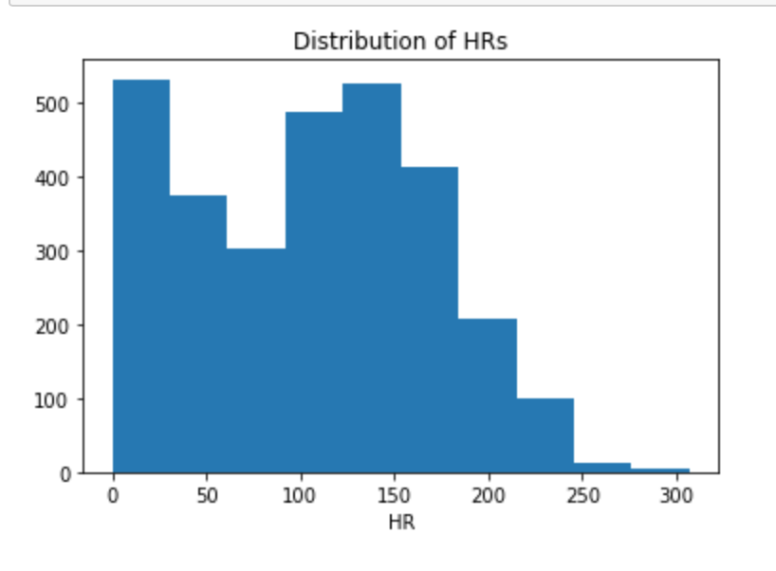
A Histogram of HRs
HRs are hard to hit and come by. So many teams with less than 100 HRs skewed this histogram for HRs.

Slide 6
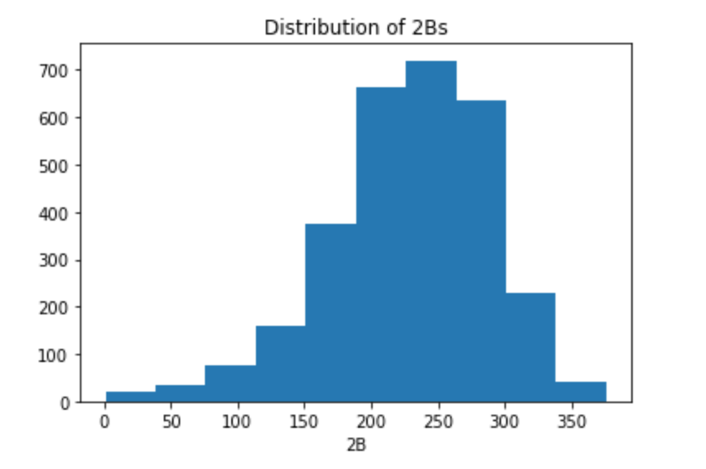
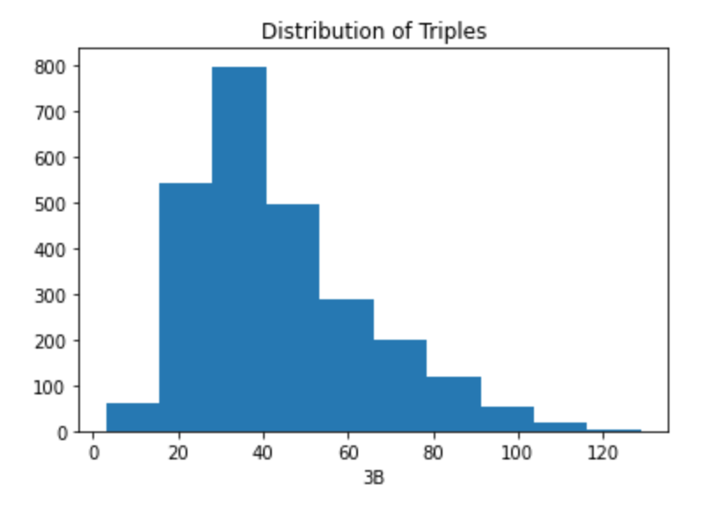
Histograms of Doubles and Triples
Doubles (2B)
Triples (3B)

Slide 7
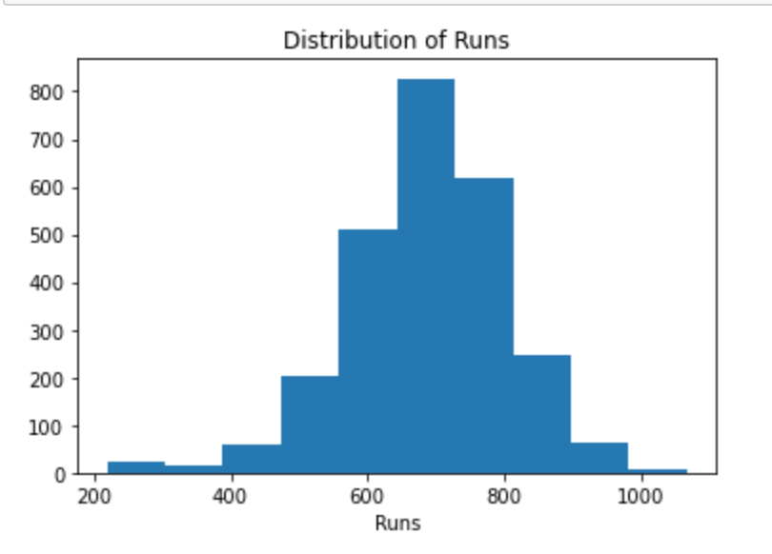
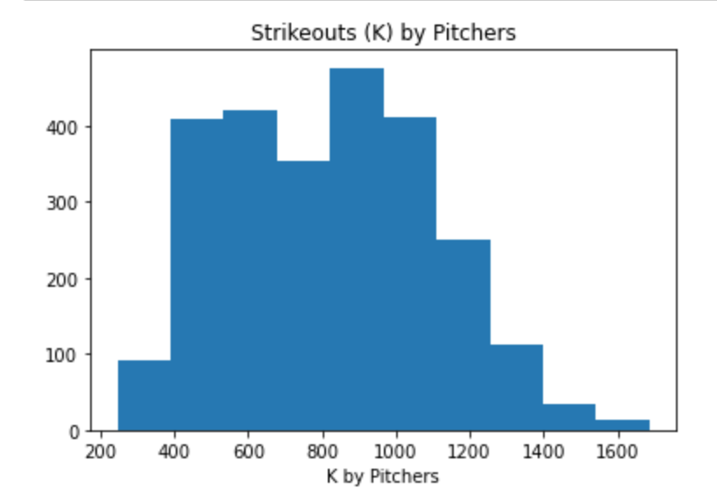
Histograms of Runs and Strikeouts by Pitchers
Runs Scored
Strikeouts by Pitchers

Slide 8
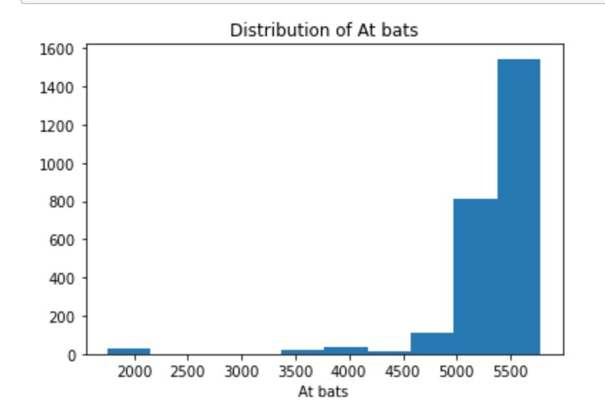
Histogram of At Bats
At Bats
Outliers Detected
Clearly, there are outliers in this At bat variable due to many of the games in the early 1900’s played less than a number of games played in later years in the 1980s.

Slide 9
Characteristics of the Variables
 | Mean | Mode | Spread | STD | Tail
Win (W) | 74.5465 | 20 | 324.65 | 18.02 | 30, 40, 22, 32, 26
HR | 104.929 | 259 | 4,038.43 | 4,038.43 | 51, 80, 62, 88, 66
2B | 228.33 | 35 | 3,597.28 | 59.98 | 73, 105, 80, 104, 112
3B | 45.909 | 488 | 504.98 | 22.47 | 7, 12, 9, 4, 12
SOA | 755.05 | 897 | 99,384.52 | 315.25 | 464, 552, 489, 519, 508
AB | 5126.26 | 5491 | 642,816.23 | 801.76 | 1752, 1975, 1936, 2023, 1968
Run | 680.496 | 682 | 19,590.64 | 19,590.64 | 401, 302, 249, 137, 302

Slide 10
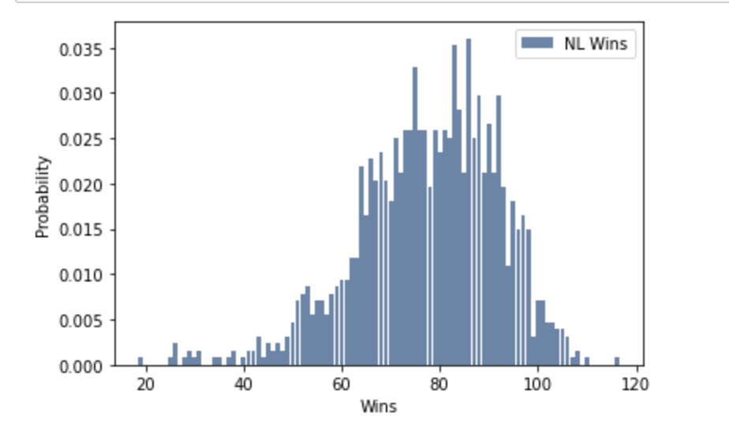
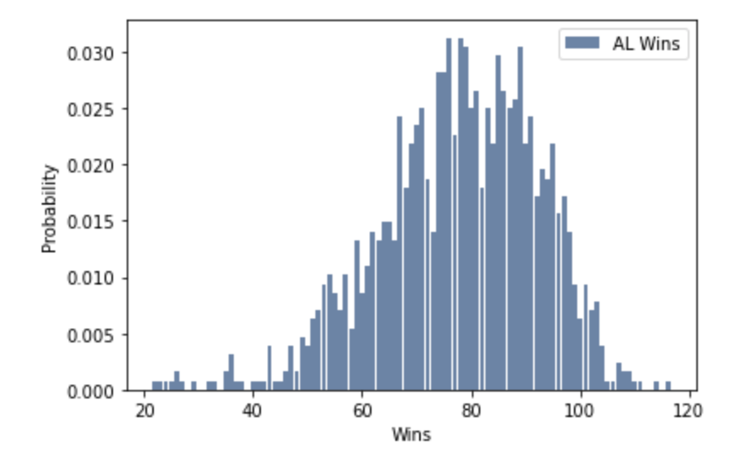
PMF of Winning for National League (NL) and American League (AL)
PDF of Winning for NL
PDF of Winning for AL

Slide 11
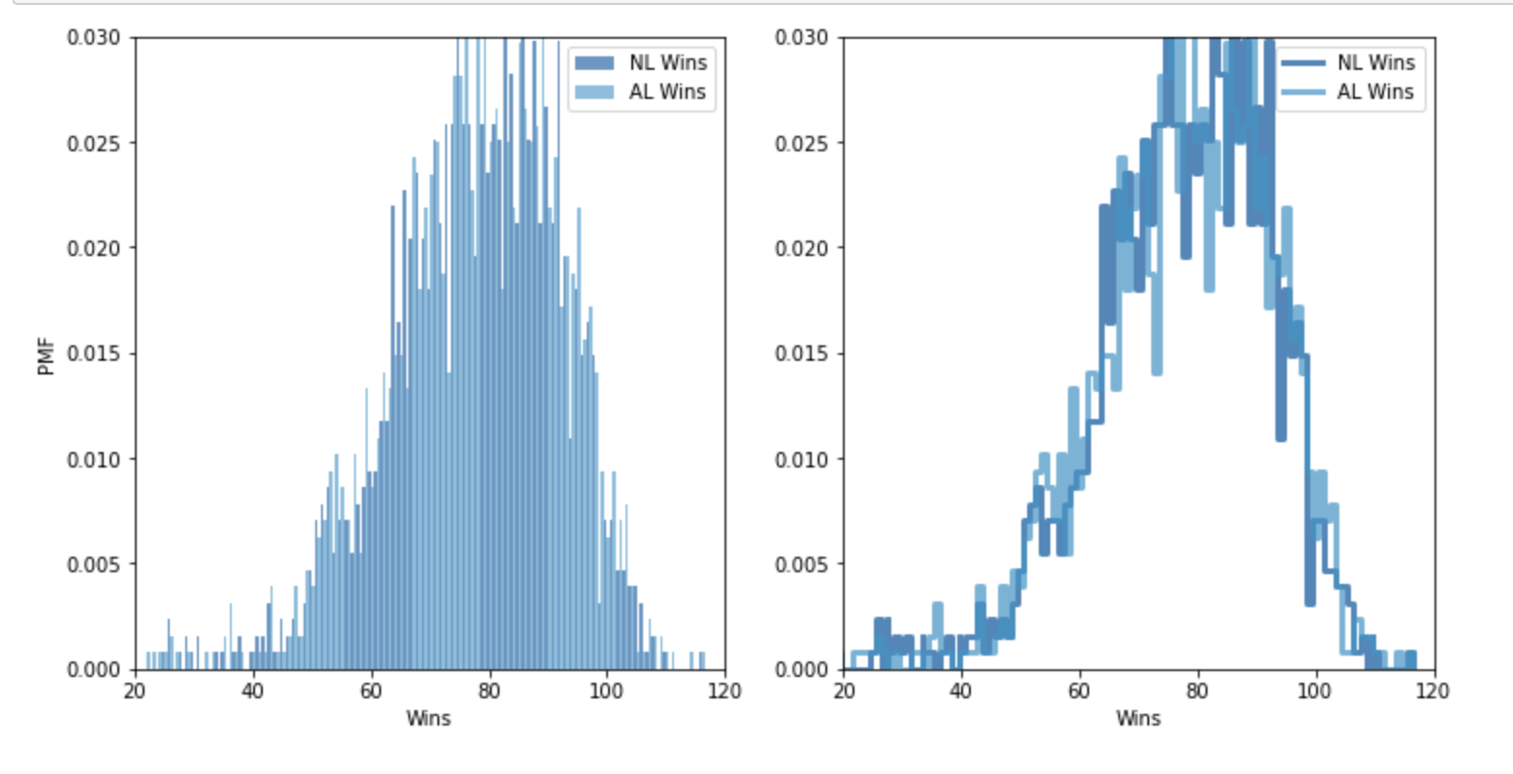
A PDF Tale of Two Leagues
There are two leagues, NL and AL, in Major League Baseball. Using a PDF of winning for each league, we can tell which league is more likely to win more games. It seems NL is likely to win more than 80 plus games given a slightly higher probability of 0.035. However, past the 90th game mark, AL seems slightly more likely to win games near the 100th game mark.
Figure 3.2 – PDF of Wins for National League and American League in MLB

Slide 12
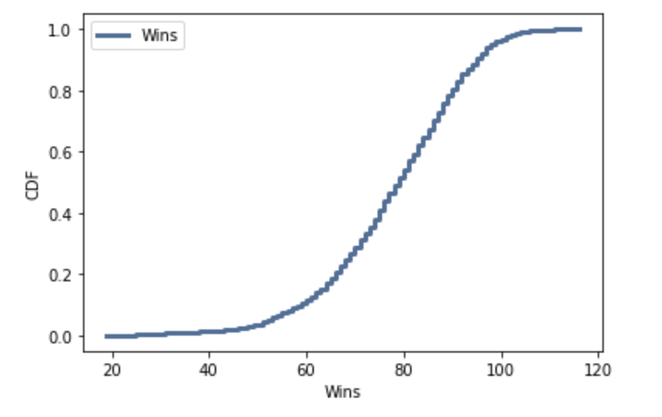
Cumulative Distribution Function (CDF) of Wins in MLB
Figure 4.1 – shows a CDF of wins in MLB. There are fewer teams that win less than 50 games as shown by the flat range in the graph as well as the teams that win more than 100 games. Also, the distribution of the graph indicates that most of the teams win within a range of 60 to 90 games.

Slide 13
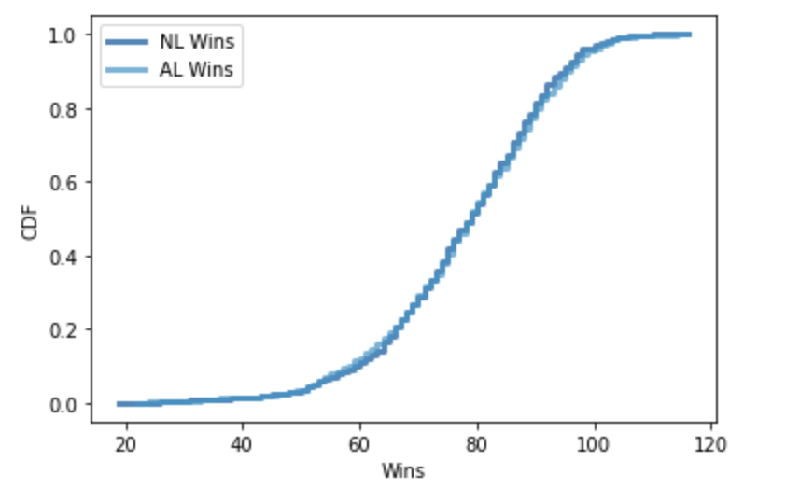
Another Tale of Two Leagues by CDF
CDF of wins for both NL and AL is pretty much consistent with what we saw in the PDF of the leagues. From 65 games to 95 games, both leagues seem identical in terms of wins even though NL slightly edges AL near the 90th game mark.
Figure 4.2 – CDF of wins for both NL and AL

Slide 14
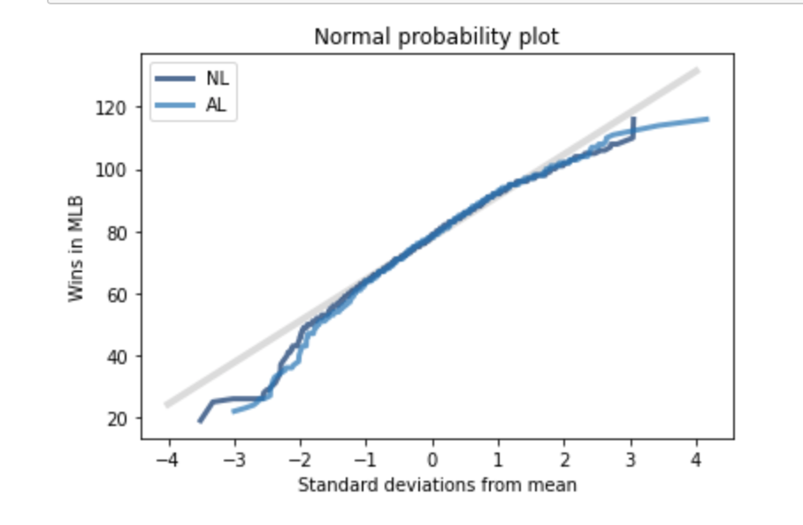
Normal Probability Plot
The normal probability plot of wins for both NL and AL shows that both distributions match near the mean on the curve (gray). But prior to STD deviation -1 from mean, both deviated quite a bit in the left tails.
Figure 5.1 – Normal probability plot of wins for NL and AL

Slide 15
Normal Probability Plot Continues…
Thus, figure 5-1 could mean that both leagues have team with poor records of winning less than 60 games a year. Those struggling teams are more, in a sense, outliers on this normal probability plot. However, it is interesting to note that in MLB, draft orders are determined by the record, meaning the worst team will be awarded with the 1st overall pick of the next year’s draft. That has led to some teams to tank (lose on purpose) by trading away their few star players.

Slide 16
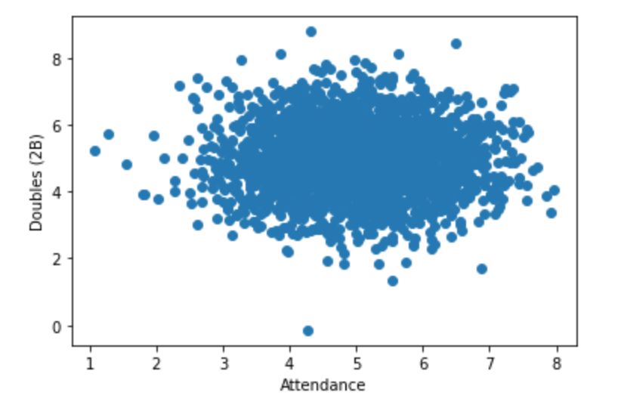
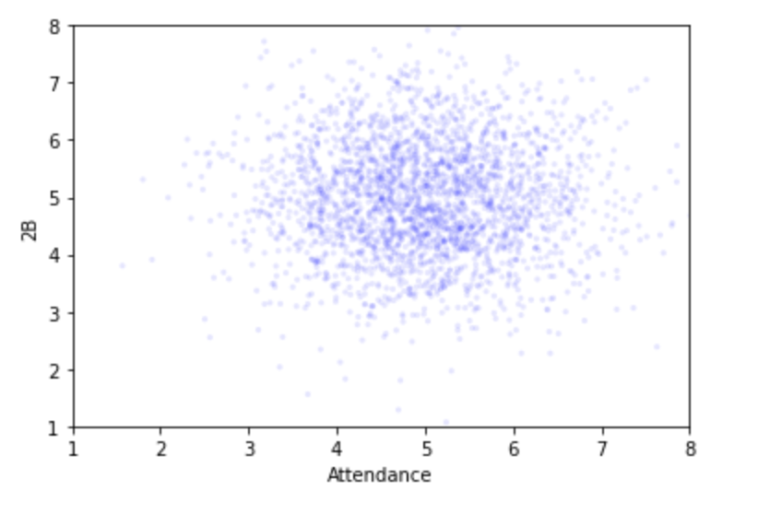
Scatter Plots: Correlation & Causation on Attendance and Doubles (2B)
Attendance (Dep. Var) vs 2B(Ind. Var)
Jittered Plot of the Left Scottered Plot

Slide 17

Correlation & Causation on Attendance and Doubles (2B)
Correlation between the two variables, doubles and attendance, was -0.0397, Pearson’s correlation 0.0461, and Spearman’s -0.0393. Thus, it does not appear that there’s a strong relationship between them.

Slide 18
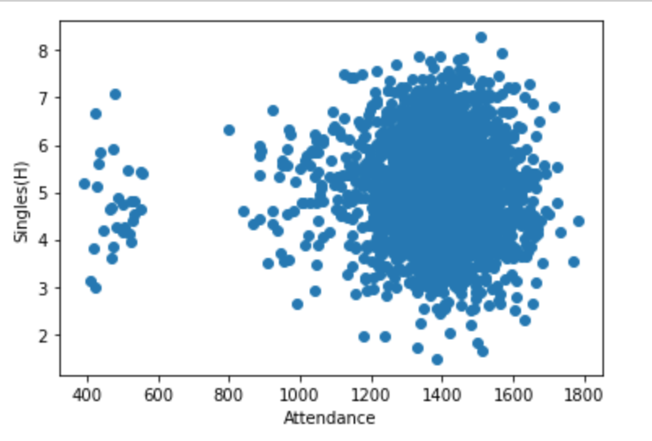
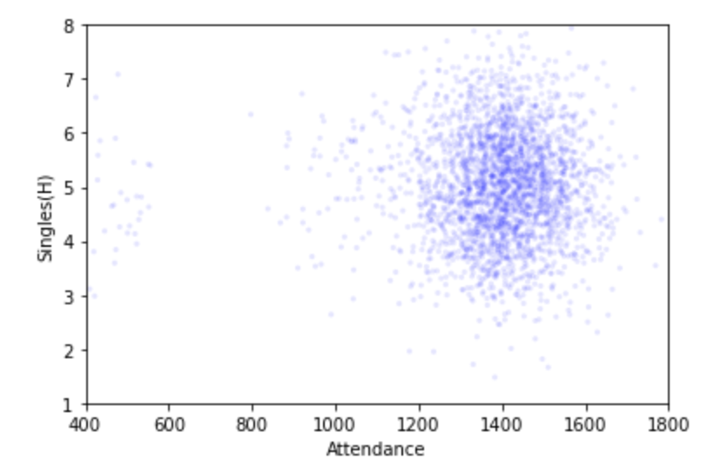
Scatter Plots: Correlation & Causation on Attendance and Singles (H)
Attendance(Dep. Var) vs Singles(Ind. Var)
Jittered Plot of the Left Scatter Plot

Slide 19
Correlation & Causation on Attendance and Singles(H)
Correlation between the two variables, doubles and attendance, was -0.996, Pearson’s correlation -0.00621, and Spearman’s 0.00716. Even though correlation of close -1.0 was strong, both Pearson and Spearman’s correlations do not support it.

Slide 20
Doubles and Attendance Revisited - A (Null) Hypothesis Analysis
Due to the weak correlation between doubles (2B) and attendance, a null hypothesis test was performed to see if hitting more doubles, which create more action around the bases, doe NOT help to increase attendance around the leagues. This null hypothesis test was to determine p-value, probability of seeing the apparent effect if the null hypothesis is true.
First, the p-value of an observed difference in means between the two variables was computed and the p-value of 0.011 came out, which was considered significant.
And then, a permutation test with a different statistic was performed, and the p-value of 0.066 was resulted, another statistically significant value.
Thus, the conclusion is that the null hypothesis is unlikely true.

Slide 21

Regression Analysis on Attendance and Strikeouts (K)
To further investigate to see if teams strikes out more (i.e. great pitching match-ups), attendance for the teams would increase.

Slide 22
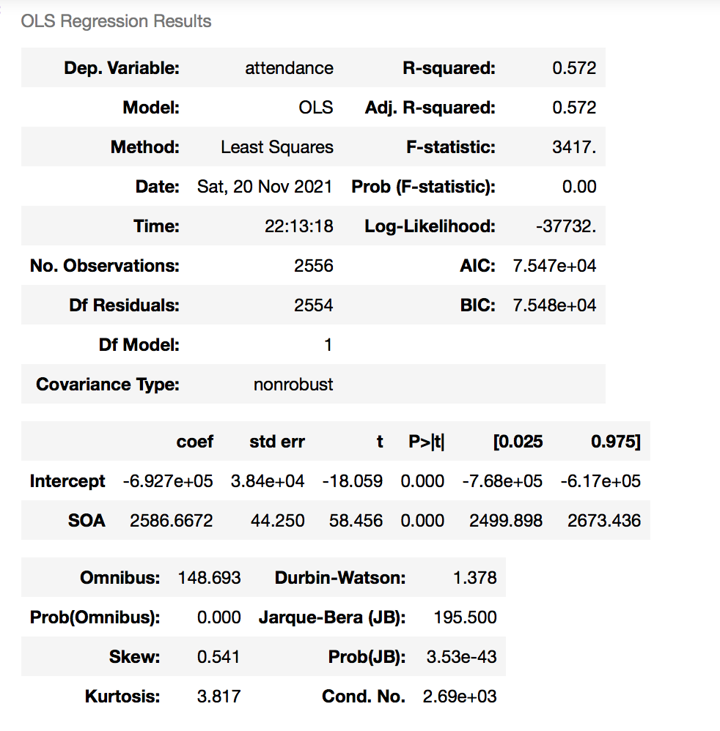
Some Interpretations on Regression Results.
R squared is 0.572 so there’s 57.2% variation in attendance can by explained by strikeouts by pitchers (SOA). The intercept is a small negative value, -6.927e+05 suggests that as SOA increases, the attendance of games decreases. This makes sense in a way since high SOA means less actions around the bases, leading many fans to believe that games are less exciting and thus causes attendance to decline.
Figure 6.1 – OLS Regression Results on Attendance and Strikeouts by Pitchers.

Slide 23
Conclusion
When examining which league in Major League Baseball is more suited for a new team to win, both American League and National Leaguea are fairly identical in terms of wins.
However, this baseball EDA analysis has shown that from 80 to 90 games (i.e Playoff worthy), NL has shown to have won more slightly more games while in AL, more teams have won from 90 to 100 plus games (league championship worthy).
More action-inducing like doubles have been said to increase attendance at the games. But based on the correlation analysis, there was no strong relationship between doubles and attendance nor single hits and attendance.

